Slide 1
Teachers on the move – Iceland – Czech Republic eea grants
Icelandic teachers visiting Liberec for job shadowing
1.11.2015-7.11.2015
Ágústa Unnur Gunnarsdóttir, teacher and interntional coordinator
Fjölbrautaskólinn í Breiðholti /Breidholt College, Reykjavík, Iceland

Slide 2
Wonderful Prag - First day in Czech Republic - Prague Castle After we landed in Prague we went to see the castel

Slide 3
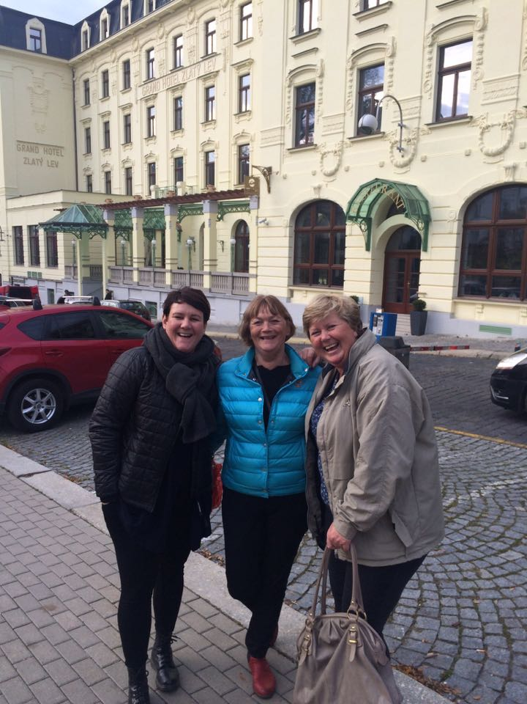
Teachers and administraton staff from Iceland : Berglind, Sigrún, Ágústa and Ágústa Unnur at the Charles Bridge in Prague and in Liberec with our project coordinator Dana Metelcová

Slide 4
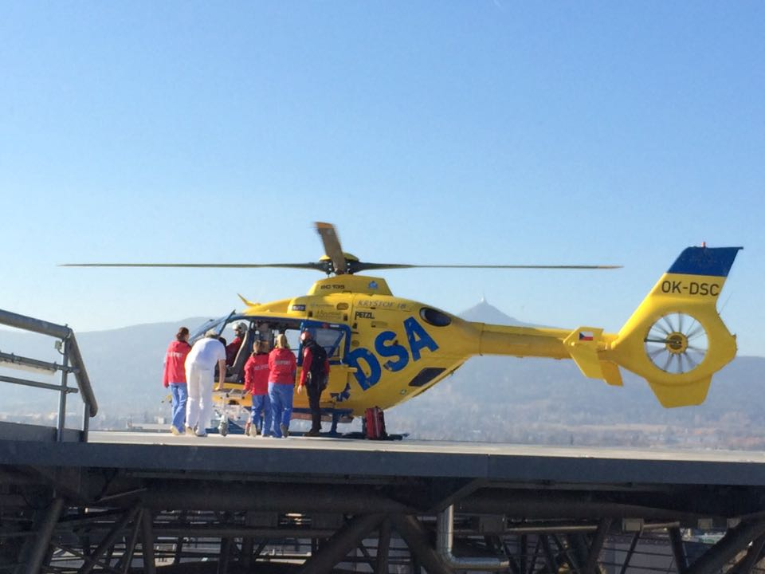
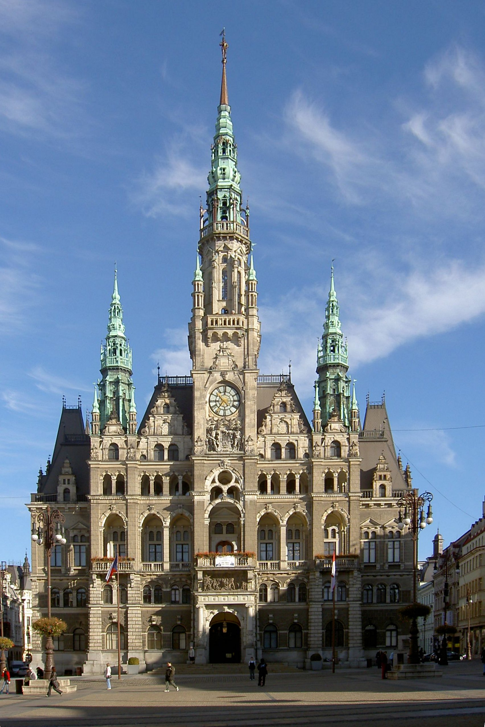
Shadowing in school - visiting and observing at the hospital in Liberec – City tour
Observing lesson at the hospital
Teachers teaching students how to prepare an appendix operation.
City tour in Liberec and Town Hall tour with a guide
Observing nursing personnel in action. Excursion to emergency services, heliport

Slide 5
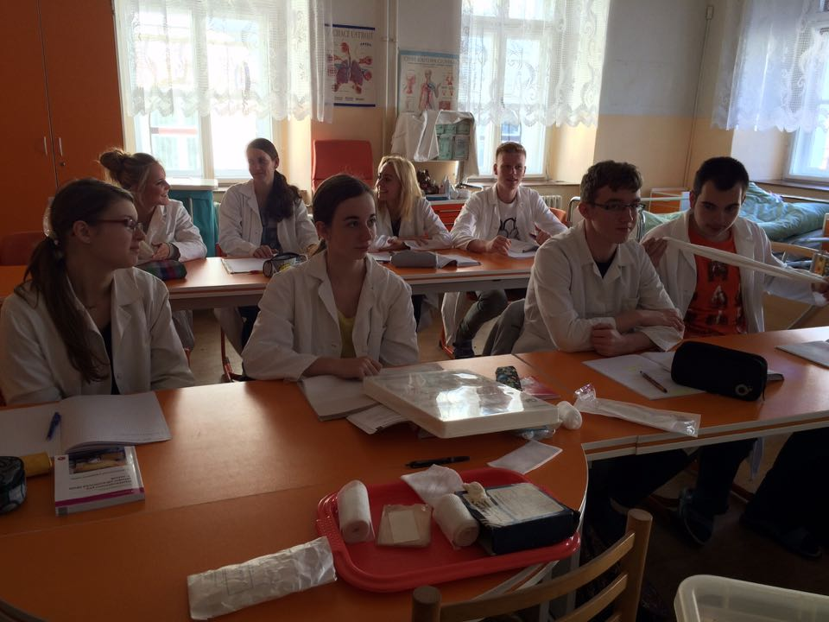
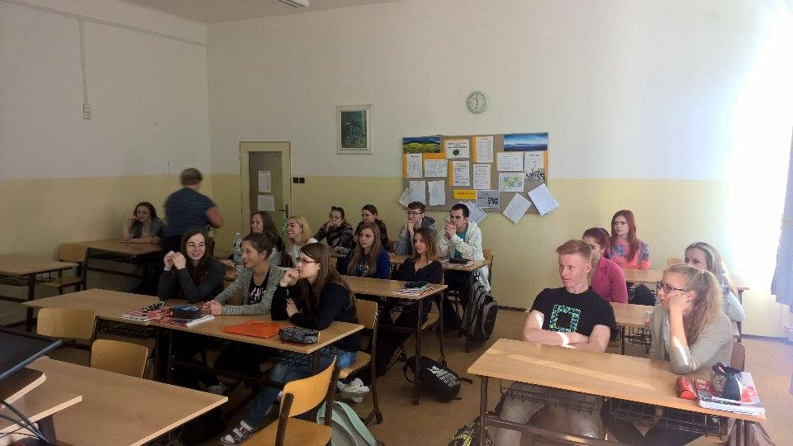
Shadowing in school Strední zdravotnická skola, Liberec
Job shadowing – oberserving nurse classes
Introducing Iceland
Observing practical teaching - nursing

Slide 6
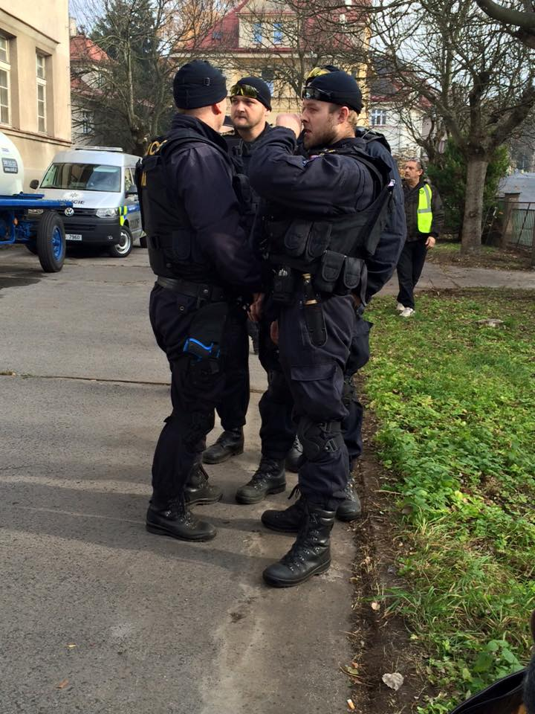
Shadowing at special school event: Cooperation with Red Cross and Prison Service Venue: Jablonec nad Nisou

Slide 7
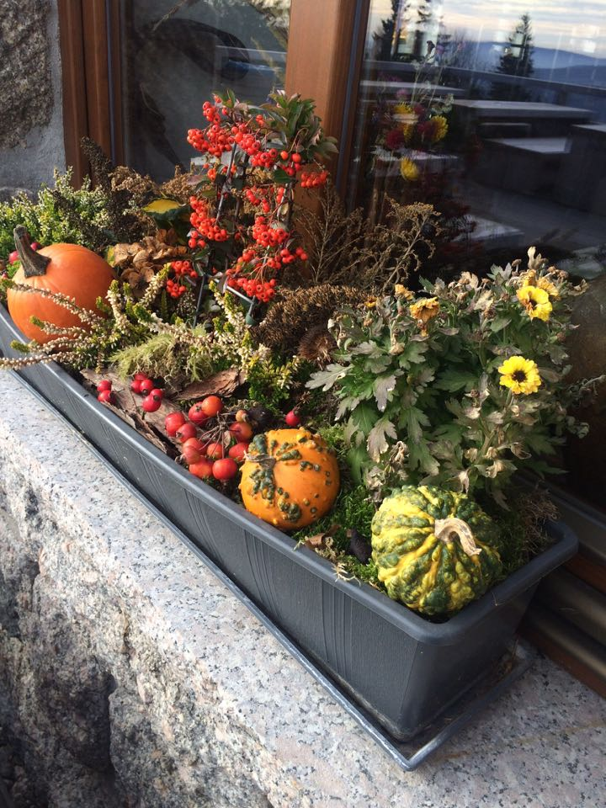
Last day : Schadowing and workshops with nurses – tutors, managers, liaison officer – project coordinator
We had a fantastic well organized
week. We learnd a lot, we saw many new and
interesting things. The whole week
was packed with fruitful learnig. We got
to know our hosts school very well and the
Education system in CZ. Aslo we
learnd how our colleges work and
we observed several lessons both
academic and vocational. We now
know a lot more about CZ and aslo
we learned that many things are
similar in these two countries.
we want to thank our hosts for the hospitality
and the good planning and we look forward seeing
you in Iceland. Thank you!

